Slide 1
Championship rules for instructors

Slide 2
Introduction
Warriors Assemble is about TSD clubs coming together and giving back to our community
REMEMBER this is a FREE event, Zi Shiying Tang Soo Do have spent months and months fundraising to make this day possible. This is only our SECOND championship, and we would really like it to be remembered for the right reasons ☺
Please support us on the day ensuring all events are SAFE and FAIR. We have first aid cover for the event, but we really hope this is not required.
We just want everyone to have a great day, make new friends and lets not forget we are giving food to our local foodbank.
This is a Charitable, Non-profit event ☺

Slide 3
HYUNGS

Slide 4
Scoring system:
7 points (lowest score for gup grades)
8 points (Lowest score for DAN grades)
9 points (Lowest score for Master grades)
up to 10 points (highest score).
2. There will be a minimum of 3 judges (from mixed clubs to ensure fair judging) for each ring.
3. Each judge will issue points according to the 7-10, 8-10 or 9-10 point scoring system with increments of 0.1.
4. All scores from each of the 3 judges will be added together to determine a total for each competitor.
5. In the event of a tie, the contestants will be asked to perform another hyung of their own choice. If this results in another tie, the contestants will be asked to perform a different hyung relevant to their grade, this hyung will be chosen by a senior judge.
6. All hyungs performed must be part of the agreed syllabus within your club or association
which your Master or Instructor teaches you, no hyungs created by individuals are permitted
to ensure fair and consistent judging.

Slide 5
HYUNGS COMPETITION REQUIREMENTS
Competitors will be required to perform traditional hyung’s during the Championships. Chil Sung hyungs will be allowed.
All hyungs must be performed in line with the competitor’s rank which is in line with your club which your instructor teaches you at that rank. You will be down marked for doing a higher hyung than your rank. e.g Red belt performing a black belt form will be down marked.

Slide 6
Free Fighting

Slide 7
FREE SPARRING
GENERAL INFORMATION AND REQUIREMENTS
There will be absolutely no jewellery worn during free sparring.
2. Fingernails and toenails will be cut to ensure no cutting or scratching of the opponent due to jagged or long nails.
3. Gum shields & protective groin guards are optional, headgear and safety hand and foot pads are
mandatory. NO UFC style hand mitts allowed. NO elasticated foot pads with just cover feet
allowed, it must be a full foot pad. If the competitor does not comply with these safety
regulations, they will not be allowed to enter this section.

Slide 8
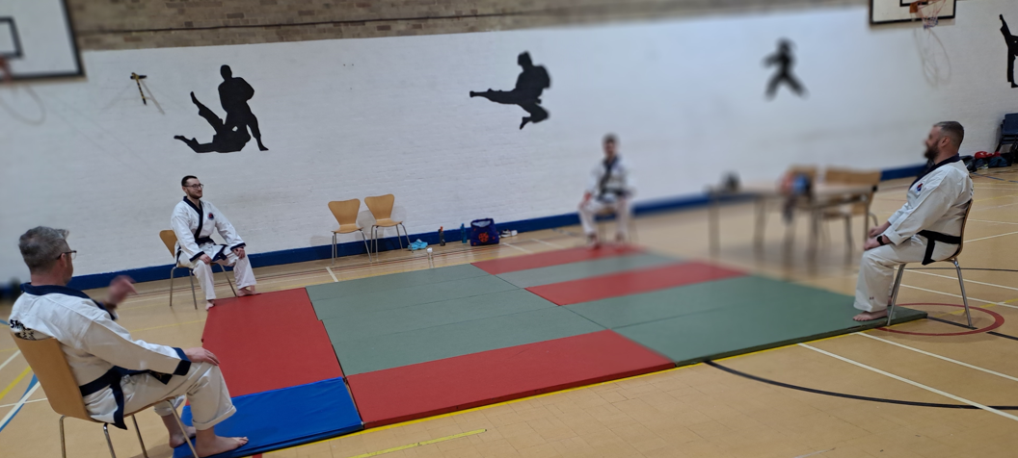
SCORING SPARRING COMPETITION
There will be 4 judges which will be sat in each corner of the ring. 1 Referee will be located in the ring with the competitors at all time and will have full control of the ring.

Slide 9
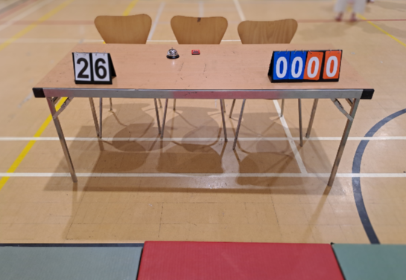
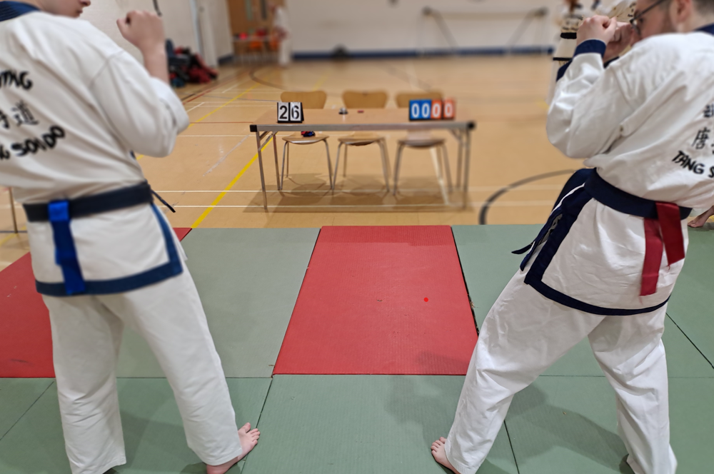
SCORING SPARRING COMPETITION
2. There are scoreboards for both competitors. RED to the right and BLUE to the left. Both competitors will have either a red or blue ribbon looped in the back of their belt and they will be stood behind their line (red to the right and blue to the left). In addition to this all Judges and the referee will all don a red wrist band on their right wrist and a blue wrist band on their left. (The referee and judges MUST roll back the cuffs on their jacket to ensure there is clear visibility of their wrist bands).

Slide 10
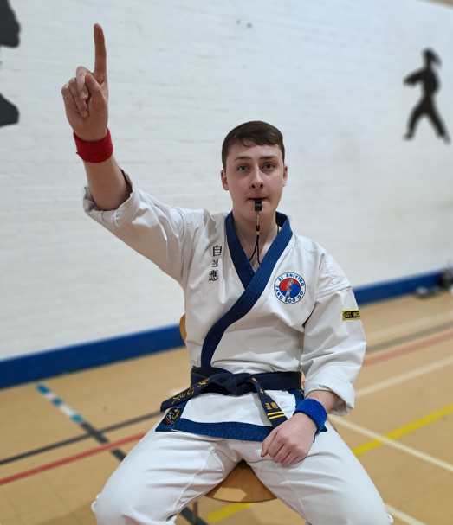
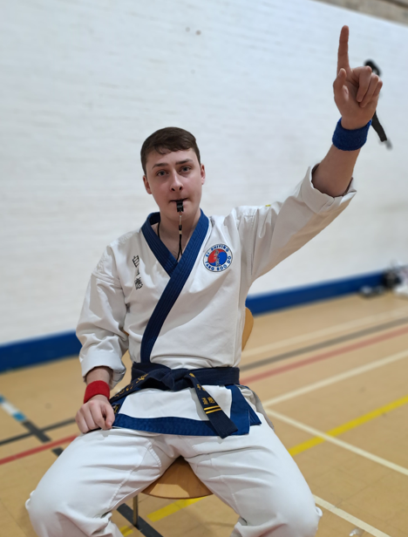
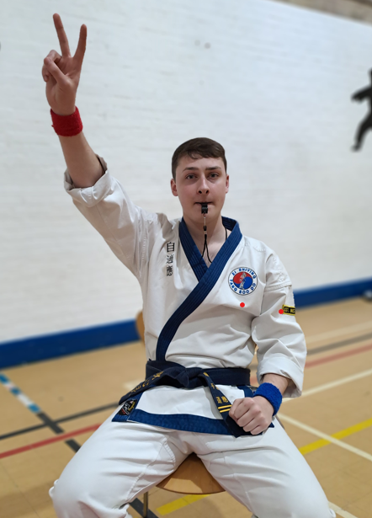
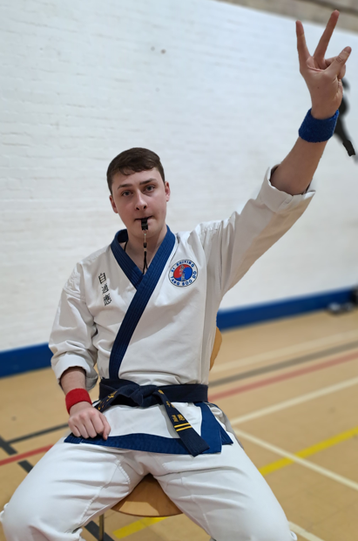
3. Judging system: Either the Referee or the Judges can blow their whistle at any time if they see a point. Further to a whistle being blown the Referee will stop the bout and signal for both competitors to stand behind their line. Once this is done the referee will blow their whistle and signal their score, at this point all judges will do the same
1 Point - Hand raised vertically 1 finger point
2 Points - Hand raised vertically 2 finger point
1 point RED 1 point BLUE 2 points RED 2 points BLUE
c. No Point – Cross clenched fists in front of your stomach.
c. Couldn’t See - Cross clenched fists in front of your stomach.
d. To Heavy Contact – Point 1 finger to the floor with wristband colour corresponding to the competitor making contact.

Slide 11
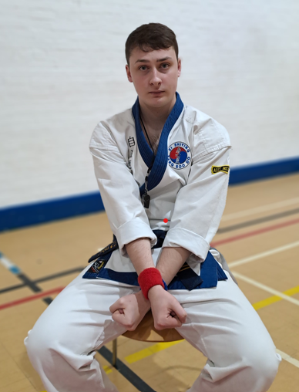
c. No Point – Cross clenched fists in front of your stomach.
c. Couldn’t See - Cross clenched fists in front of your stomach.
d. To Heavy Contact – Point 1 finger to the floor with wristband colour corresponding to the competitor making contact.

Slide 12
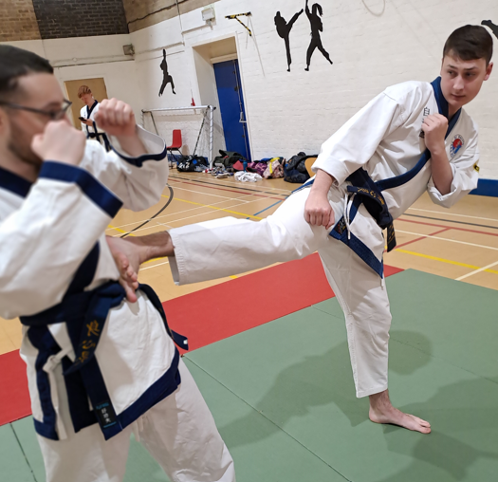
4. Score card
a. 1 points for controlled kick to the head
b. 1 point for controlled kick to the body

Slide 13
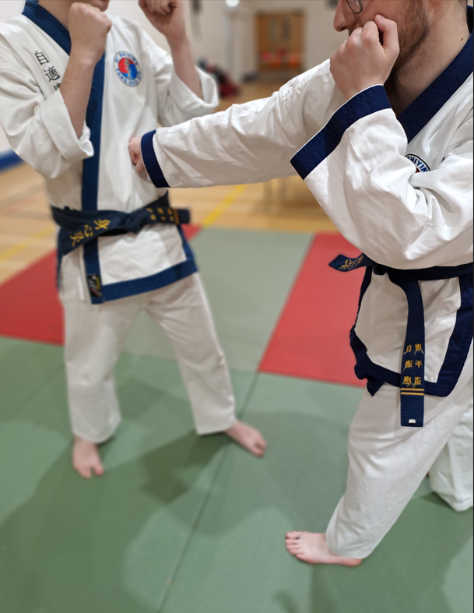
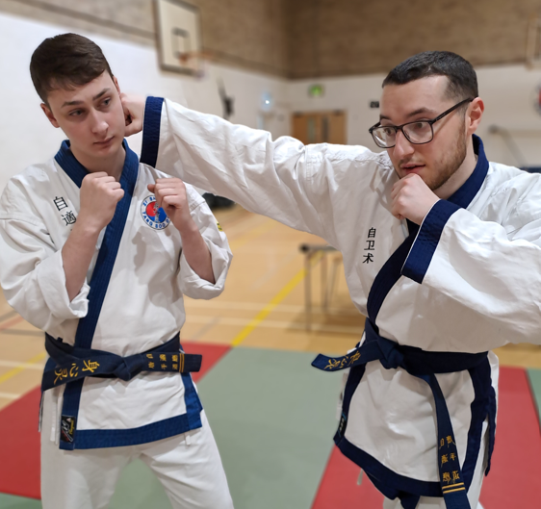
4. Score card
c. 1 point for controlled punch/back fist to the body
d. 1 point for controlled punch/back fist to the head

Slide 14
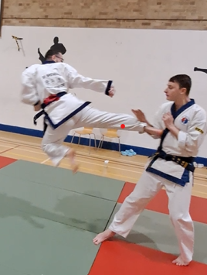
e. 2 point for controlled jump kick with both feet off the floor,

Slide 15
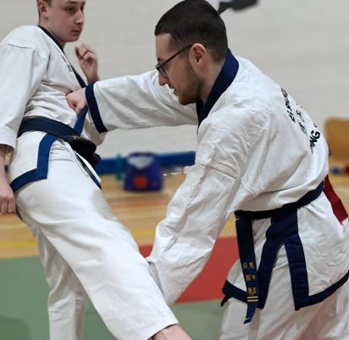
f. 2 points for blocking and counter (counter can be with a punch or kick)
g. 10 points maximum for winner, must win by two clear points
h. A point will only be awarded on a majority of 3 out of 5

Slide 16
5. Fight duration will be 1.5 mins for under 18s and 2 minutes for over 18s, if competitors have drawn then the next point scored will determine the winner.
6. All competitors MUST kee-hap to score. Regardless of technique NO KE-HAP NO SCORE
7. Warnings or disqualification will be given if any of the following occur:
a. Sweeping of the competitors leg
b. Any intentional contact is given; this will result in instant disqualification.
c. Excessive contact, especially to the face e.g. which draws blood WILL lead to a
disqualification (bleeding from the nose etc.)
8. Angry and uncontrolled competitors which have had two warnings will be stopped and disqualified by the centre ring judges to prevent the opponent getting injured. You will get warnings for using unsighted techniques e.g. spinning back fist, kicks below the belt, attacks to the back or the back of the head etc..
9. Team Sparring (When applicable) – Teams of 1 lady and 3 men which must be over 18. All 4 team members will fight one fighter from the opposition team (Male v Male and Female v Female). Teams will be added to a Free fighting grid and will compete through to the final.

